Slide 1
A new hope
Team Indigo
P&O Computerwetenschappen
Wander Bavin
Vince Goossens
Dimitri Jonckers
Sunil Tandan
Wout Vekemans
Notes:
Wander

Slide 2
contents
Assignment
Physical design
Software
Algorithms
Demo
Collaboration
Conclusions
Notes:
Wander

Slide 3
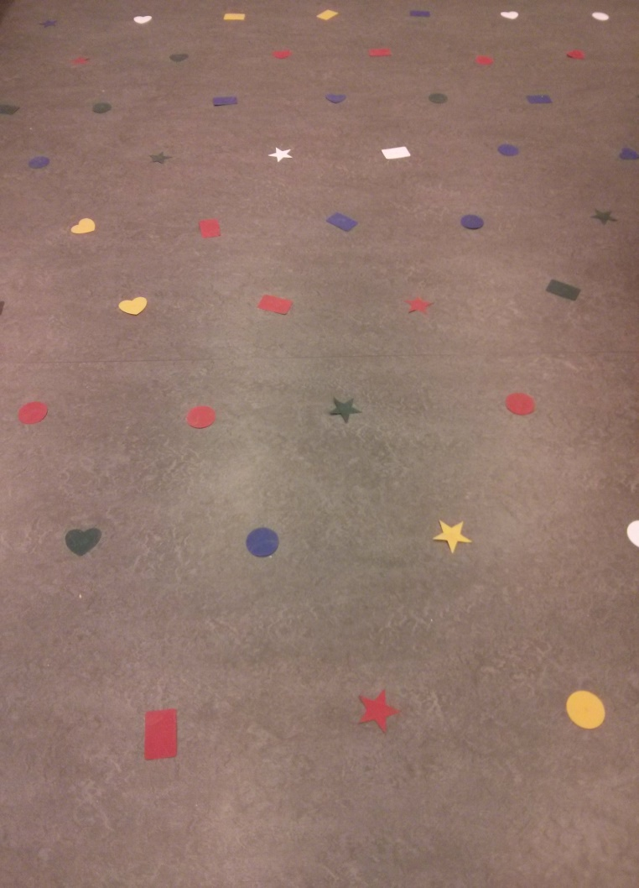
Assignment
Autonomous zeppelin
Grid manoeuvring
Zeppelin race
Notes:
Wander

Slide 4
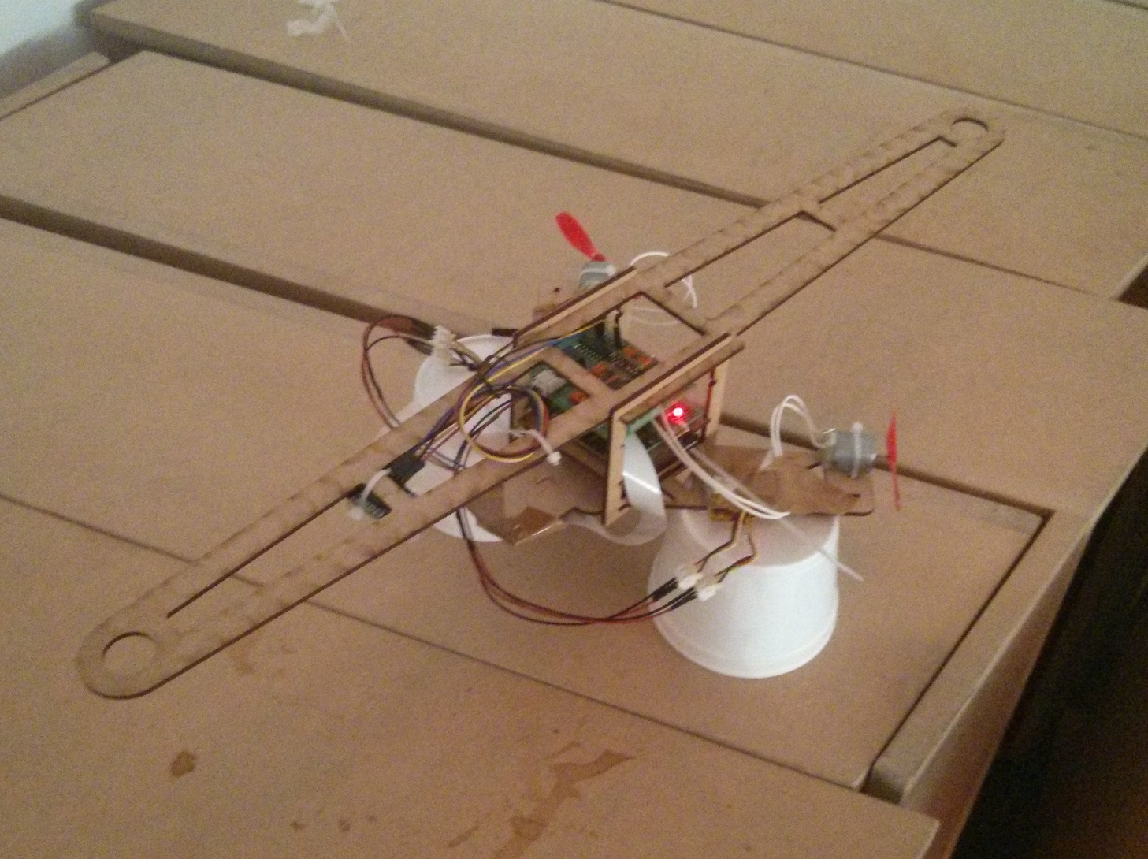
Physical Design
Notes:
Wander

Slide 5
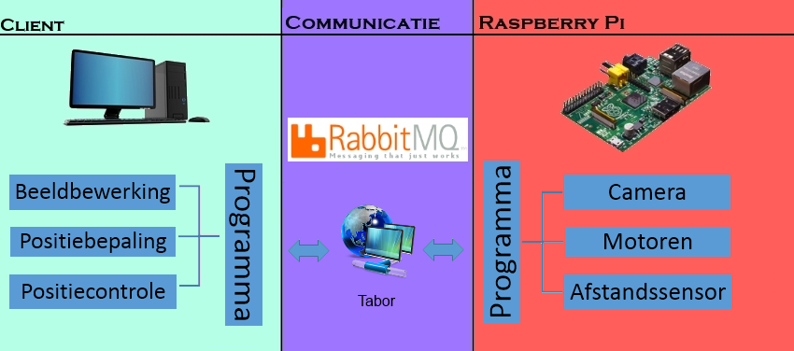
Software
Java
Open CV
Notes:
Wander
Meer op pc -> problemen opencv -> veel naar client

Slide 6

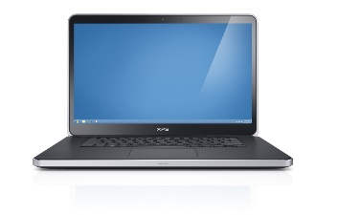
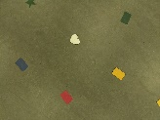

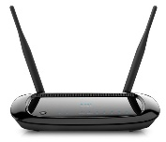

Communication
Ad-hoc
image feed (pi → laptop)
Rabbit MQ
status, commands…
Notes:
Wander

Slide 7
Algorithms
PID
Height
Horizontal: x,y
Image recognition
Positioning
Image recognition video
Notes:
Vince
PID controlls
Recognize colours and shapes on the grid
Optimalisation to optimize recogniton and positioning
Shapes (equiterale triangle) -> position zeppelin above the grid
Problems at the demo

Slide 8
Pid
Height
Same parameters previous semester
Horizontal
Independent x and y
Simple navigation (no rotation)
Notes:
Height
New frame -> parameters still correct
Horizontal
Movements split in x and y
Different PID -> each motor

Slide 9
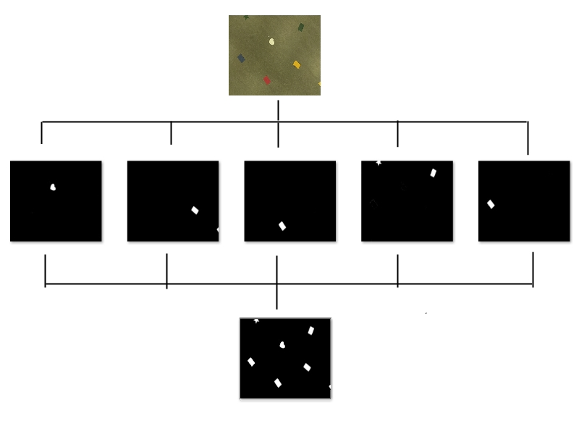
Image Recognition
Colour accurate, shapes mostly
Correction previous recognitions
Notes:
Filtring on 5 colours
Add images together
Recognize contours
Previous recognition: based on position on picture (threshold circle round previous point depended on #frames)

Slide 10
Image recognition
Colour Symbol at incomplete triangle
Multiple triangles → unknowns
→ distance to center
(foto van herkenning met een driehoek met een kleursymbool)
Notes:
Vince
Shapes -> equiteral triangle
NO Triangle of three shapes – color, no contour
Distance to center
-> position locator exact to middlepoint (Dimi in positioning)

Slide 11
Positioning
Location
Unique triangle
Multiple possibilities (unknowns)
Correction previous location
Orientation
Horizontal symbols on map (// grid edge)
Notes:
Dimi

Slide 12
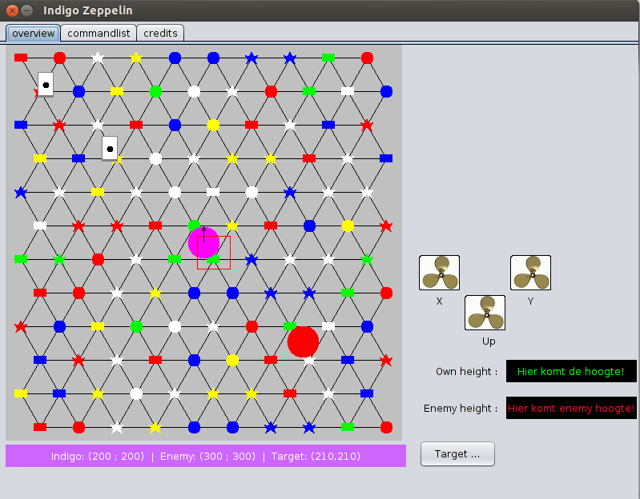
Simulator

Slide 13
Demo: accomplishments
Height PID
Connection could be established
Simulator
Both simulators worked
Target movement
Qr-code
Image recognition
Accurate

Slide 14
demo: disappointments
Positioning error
grid size
QR-code error
tablet trouble

Slide 15
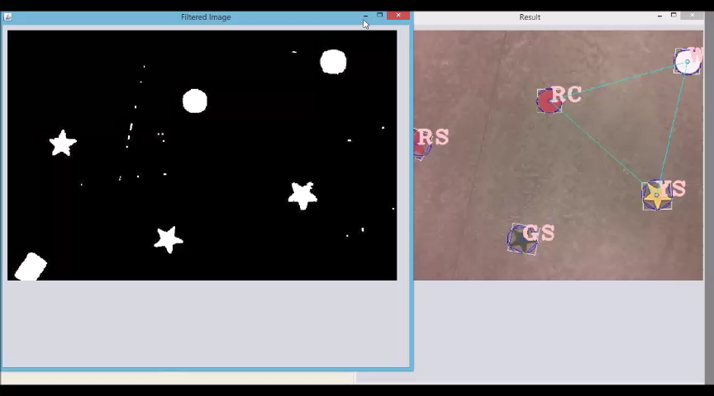
Image recognition video

Slide 16
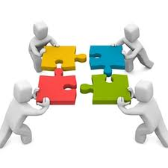
collaboration
Experiences
Great atmosphere
Knowledge apprehended
Difficulties
Dividing workload
Notes:
Vince
Knowlegde:
Image recognition, PID, RSA, Communcation
Work divided ->
Thrust on partners -> good work + good documentation

Slide 17

Conclusion
Strengths
Robust image recognition
Advanced positioning
Design zeppelin (no rotation)
Difficulties
Only five people
Trouble at demonstration
Java/Open Cv
Notes:
Colours perfect, shapes mostly, Optimizations
previous forms / previous positions on grid
Demo -> size of the grid
Java/opencv -> not much examples on the web
No opencv on the pi (really big tutorial)

